Slide 1

INTRODUCTION TO STATISTICAL DATA ANALYSIS USING R & RSTUDIO
LUMUMBA WANDERA VICTOR
(M.Sc. Applied Statistics)
11th February, 2025
.

Slide 2
Session 1: Introduction to R, Rstudio, and Basic Data Types
History about R
R, a powerful and open-source programming language, has become a cornerstone in the realm of data analysis and statistical computing. Developed by statisticians and data scientists, R offers a versatile environment for handling, exploring, and visualizing data. Its extensive collection of packages and libraries caters to a wide array of statistical and machine learning techniques, making it an invaluable tool for researchers, analysts, and postgraduate students alike. Whether you are cleaning and manipulating datasets, conducting exploratory data analysis, or building sophisticated predictive models, R provides a seamless and reproducible workflow. With its syntax designed for ease of use and a vibrant community that contributes to its growth, R serves as a fundamental skill for those seeking to unravel the insights hidden within the vast landscape of data. As we embark on this journey of learning, the versatility and efficiency of R will empower you to navigate the intricacies of data analysis and derive meaningful conclusions from complex datasets.
Although R is a programming language, it is unlike most others. It is designed to analyze data. It isn’t too difficult to learn, and is extremely popular. R has the advantage that it is free and open-source, and that thousands of users have contributed “add-on” packages that are readily downloadable by anyone. R is found in all areas of academia that encounter data, and in many private and public organizations. R is great for any job or task that uses data.
2/8/2025
CENTER FOR DATA ANALYTICS AND MODELING, CHUKA UNIVERSITY
2

Slide 3
Session 1: Introduction to R, Rstudio, and Basic Data Types
What is R?
Although R is a programming language, it is unlike most others. It is designed to analyze data. It isn’t too difficult to learn, and is extremely popular.
R has the advantage that it is free and open-source, and that thousands of users have contributed “add-on” packages that are readily downloadable by anyone.
R is found in all areas of academia that encounter data, and in many private and public organizations. R is great for any job or task that uses data.
2/8/2025
CENTER FOR DATA ANALYTICS AND MODELING, CHUKA UNIVERSITY
2

Slide 4
Session 1: Introduction to R, Rstudio, and Basic Data Types
Where to get R and Rstudio
Both are free and open-source. Download and install R first: https://cran.r-project.org/bin/windows/base/ (for Windows) or https://cran.r-project.org/bin/macosx/ (for Mac).
Then, download and install RStudio from https://www.rstudio.com/products/rstudio/download/.
2/8/2025
CENTER FOR DATA ANALYTICS AND MODELING, CHUKA UNIVERSITY
2

Slide 5
Session 1: Introduction to R, Rstudio, and Basic Data Types
Open Rstudio
Search your computer for RStudio.exe and open the application. It should look something like the image in the next slide
2/8/2025
CENTER FOR DATA ANALYTICS AND MODELING, CHUKA UNIVERSITY
2

Slide 6
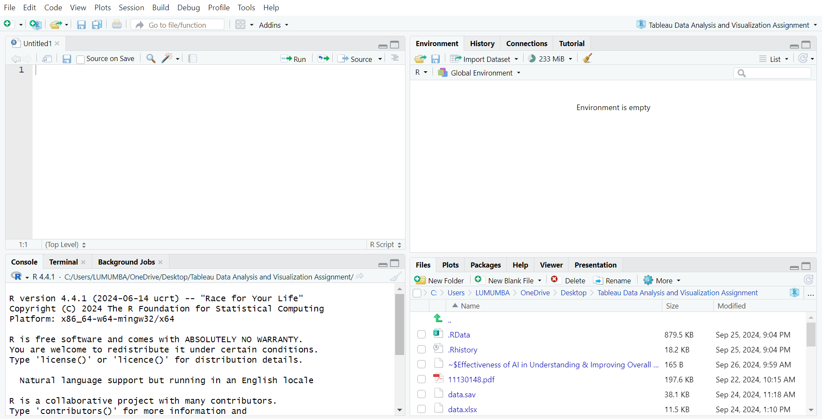
Session 1: Rstudio Environment
2/8/2025
CENTER FOR DATA ANALYTICS AND MODELING, CHUKA UNIVERSITY
2

Slide 7
Session 1: Rstudio Pane Layout
2/8/2025
CENTER FOR DATA ANALYTICS AND MODELING, CHUKA UNIVERSITY
2

Slide 8
Session 1: Introduction to R, Rstudio, and Basic Data Types
Open Rstudio
Search your computer for RStudio.exe and open the application. It should look something like the image in the next slide
2/8/2025
CENTER FOR DATA ANALYTICS AND MODELING, CHUKA UNIVERSITY
2

Slide 9
Session 1: Introduction to R, Rstudio, and Basic Data Types
Open Rstudio
Search your computer for RStudio.exe and open the application. It should look something like the image in the next slide
2/8/2025
CENTER FOR DATA ANALYTICS AND MODELING, CHUKA UNIVERSITY
2

Slide 10
Session 1: Introduction to R, Rstudio, and Basic Data Types
Basic R Syntax, Commands and Data Types
Open the link below to learn more about R basic syntax and commands
https://docs.google.com/spreadsheets/d/1146Y7ZYtzs6Mvu14igio-vIoGMdTJS3SC27mp7lnwGU/edit?usp=sharing
2/8/2025
CENTER FOR DATA ANALYTICS AND MODELING, CHUKA UNIVERSITY
2

Slide 11
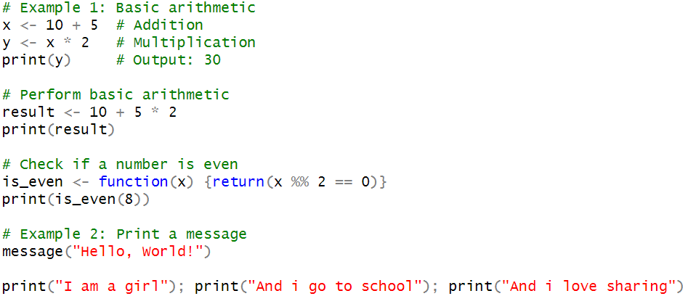
Session 1: Introduction to R, Rstudio, and Basic Data Types
Basic R Syntax, Commands and Data Types (Sample R Codes)
Arithmetic Operations
2/8/2025
CENTER FOR DATA ANALYTICS AND MODELING, CHUKA UNIVERSITY
2

Slide 12
Session 1: Create and Manipulate Vectors
1. Vectors
A vector is a fundamental data structure in R that holds elements of the same data type (numeric, character, logical, etc.).
It is one-dimensional and homogeneous (all elements must be of the same type).
Vectors are widely used in R for data manipulation, mathematical operations, and indexing.
They support arithmetic operations, logical comparisons, and vectorized operations (element-wise operations).
Vectors can be indexed using position numbers or logical conditions.
2/8/2025
CENTER FOR DATA ANALYTICS AND MODELING, CHUKA UNIVERSITY
2

Slide 13
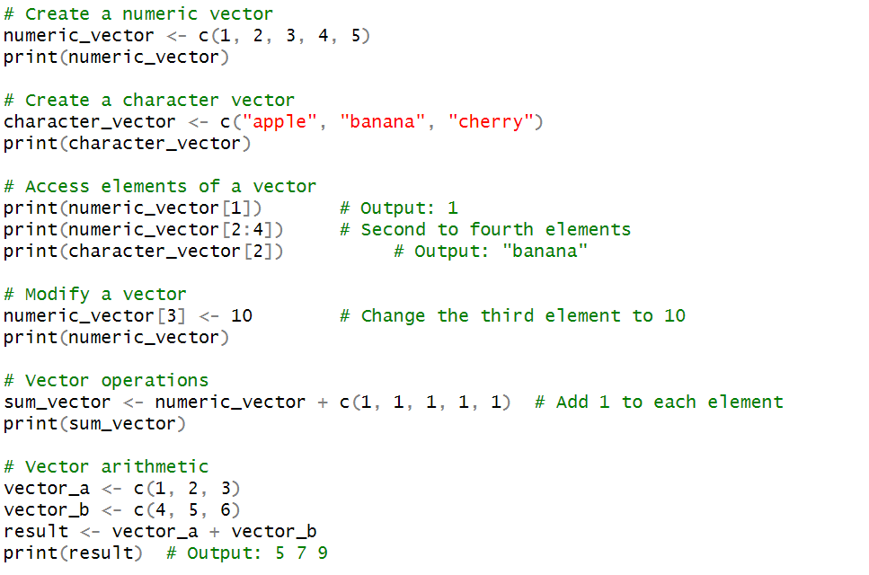
Session 1: Create and Manipulate Vectors
2/8/2025
CENTER FOR DATA ANALYTICS AND MODELING, CHUKA UNIVERSITY
2

Slide 14
Session 1: Create and Manipulate Matrices
2. Matrices
A matrix is a two-dimensional rectangular array in R that contains only one type of data (numeric, character, etc.).
It consists of rows and columns.
Matrices allow arithmetic operations, element-wise operations, and matrix multiplication.
They are commonly used in linear algebra, statistics, and data analysis.
Rows and columns can be accessed using indices.
Operations like transpose, addition, subtraction, and determinant calculation can be performed on matrices.
2/8/2025
CENTER FOR DATA ANALYTICS AND MODELING, CHUKA UNIVERSITY
2

Slide 15
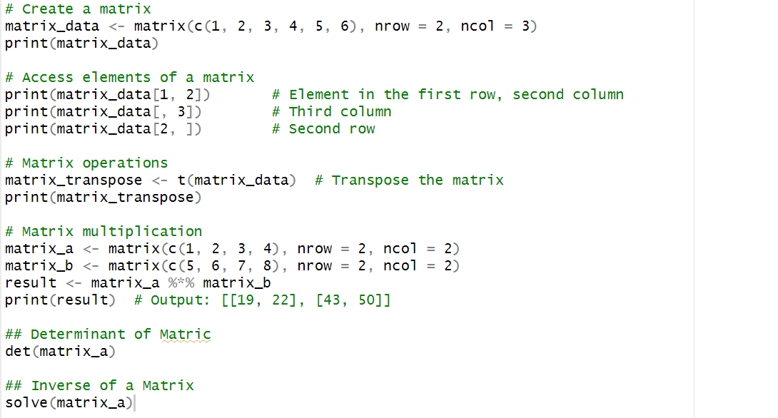
Session 1: Create and Manipulate Matrices
2/8/2025
CENTER FOR DATA ANALYTICS AND MODELING, CHUKA UNIVERSITY
2

Slide 16
Session 2: Create and Manipulate Lists
3. Lists
A list in R is a flexible data structure that can contain different types of data (vectors, matrices, data frames, functions, etc.).
Lists are heterogeneous, meaning they can store elements of different data types.
They can contain nested lists, allowing for complex data storage.
Lists are useful for storing results from statistical models, organizing large datasets, and handling multiple data structures.
Elements in a list can be accessed using names, indices, or the $ operator.
2/8/2025
CENTER FOR DATA ANALYTICS AND MODELING, CHUKA UNIVERSITY
2

Slide 17
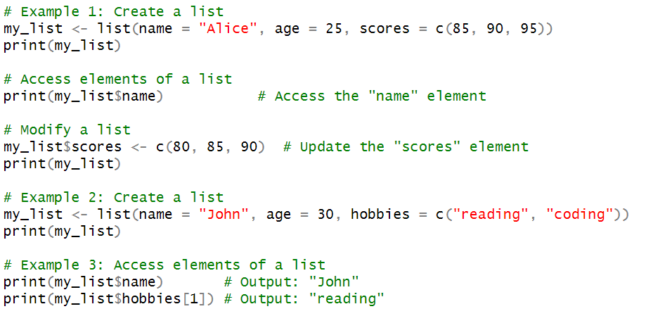
Session 2: Create and Manipulate Lists
2/8/2025
CENTER FOR DATA ANALYTICS AND MODELING, CHUKA UNIVERSITY
2

Slide 18
Session 1: Create and Manipulating Data Frames
1. What is a Data Frame?
A data frame is a two-dimensional table-like structure in R that stores heterogeneous data types (numeric, character, factor, etc.), similar to a spreadsheet or SQL table. It is one of the most commonly used data structures in R for data analysis.
2. Characteristics of a Data Frame
Consists of rows and columns.
Each column must contain the same data type, but different columns can have different types.
Rows represent observations, and columns represent variables.
Supports indexing, subsetting, filtering, and manipulation.
2/8/2025
CENTER FOR DATA ANALYTICS AND MODELING, CHUKA UNIVERSITY
2

Slide 19
Session 1: Creating and Manipulating Data Frames
3. Common Operations on Data Frames
Checking Structure: Functions like str(), summary(), head(), and tail() help inspect the data frame.
Accessing Data: You can extract columns using $, [[ ]], or [ , ] notation.
Filtering and Subsetting: You can filter rows based on conditions (e.g., selecting all rows where age > 30).
Adding or Removing Columns: You can create new columns, rename them, or drop unnecessary ones.
Handling Missing Data: Missing values (NA) can be detected and handled using functions like na.omit() or is.na().
Merging and Joining: Data frames can be combined using functions like merge() or cbind() / rbind().
2/8/2025
CENTER FOR DATA ANALYTICS AND MODELING, CHUKA UNIVERSITY
2

Slide 20
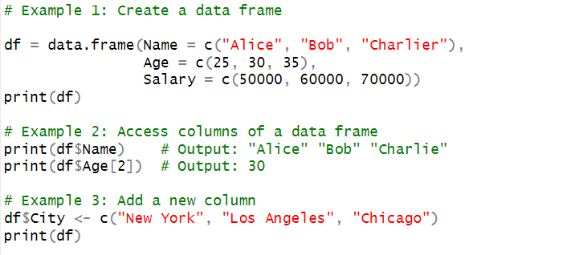
Session 1: Create and Manipulate Data Frames
2/8/2025
CENTER FOR DATA ANALYTICS AND MODELING, CHUKA UNIVERSITY
2

Slide 21
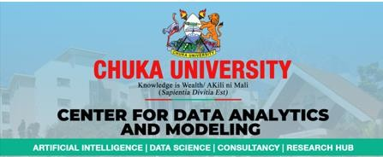
https://cdam.chuka.ac.ke
Thank you
2/8/2025
CENTER FOR DATA ANALYTICS AND MODELING, CHUKA UNIVERSITY

